Slide 1
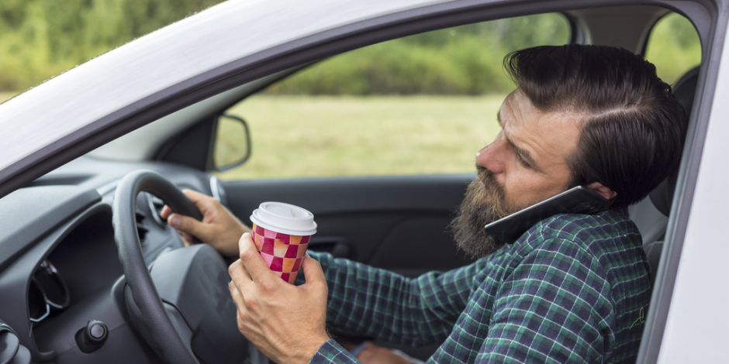
Driver Distractions Detection Project

Slide 2
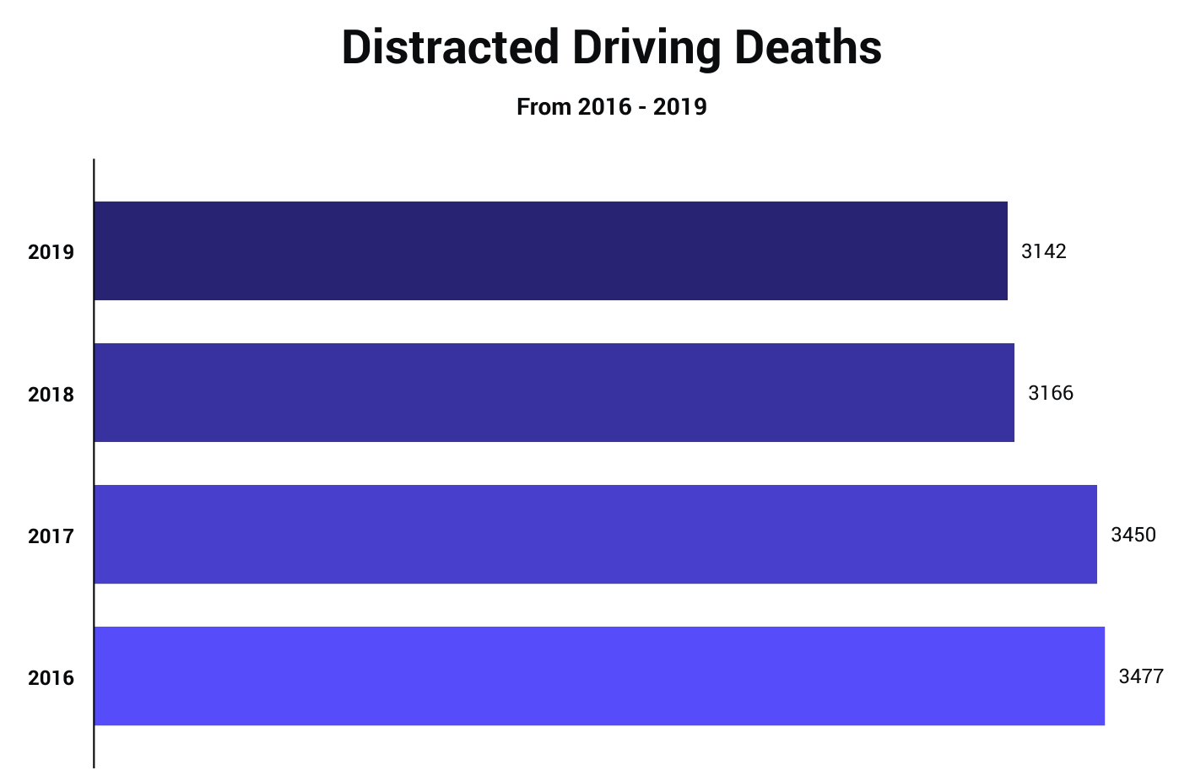
Motivation
The NHTSA data states that roughly, In the United States, approximately 9 people are killed and more than 1,000 injured daily
Notes:
منظمه ال NHTSA عملت احصائيه ان ف اليو اس حوالي تسع اشخاص بيموتوا والف واحد بينصابوا يوميا بسبب حوادث السيارات الناتجه عن الدستركشن الي السائق بيعمله اثناء القياده
الجراف الي قدامنا دا موضح عدد الوفيات الي بتحصل سانويا بسبب الدستركن وهنلاقي ان هي تقريبا ف رنج تلاتلاف ونص فرد وبالتالي
احنا بنينا المشروع بتاعنا ان يرصد التشتت الي السائق ممكن يعمله بايده اثناء القياده وكمان ينبهه زي ماهنوضح بعد شويه

Slide 3
Application Workflow
If the behavior is detected to be bad it warns the driver by alert
It then looks for any distracting behavior shown by the driver
The app starts of with the camera running
and it looks for the driver in the video
The driver behavior stored in a database
3
2
4
1

Slide 4
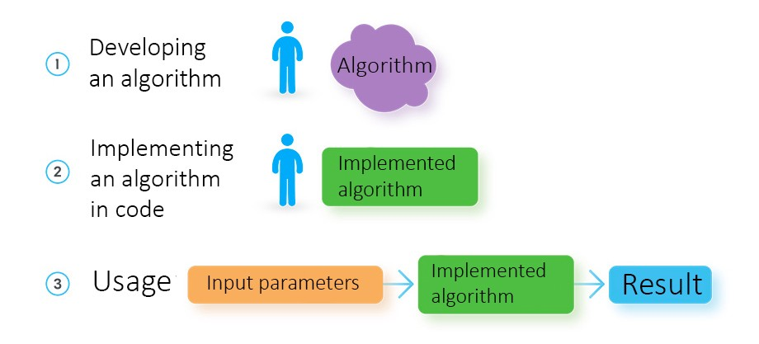
How a software developer creates a solution
4
Notes:
ف البرمجه العاديه المبرمج بيبقي عاوز يعمل ابلكشن معين ف بيختار الالجورزم المناسب معاه وبعدين يبدا يحط السنريوهات المتوقعه للانبوت بتاعه زي مثلا لو اليوز ضغط علي الزرار الفلاني هبدا اديله خرج معين

Slide 5
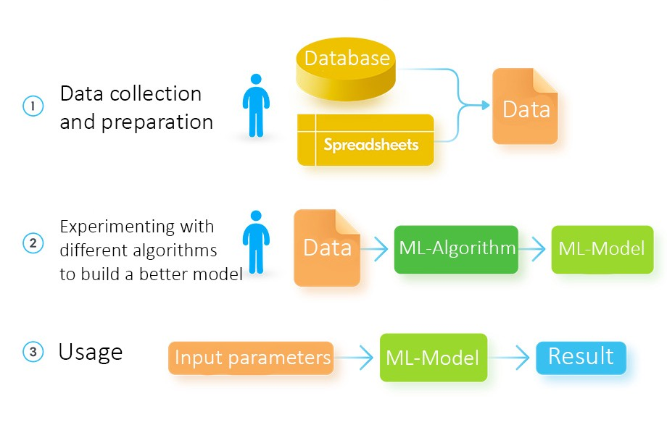
How a data engineer develops a solution using machine learning
5
Notes:
اما هنا بيبقي عندي عنصر جديد اسمه الداته سيت دي وظيفتها اني اخلي البروجرم بتاعي يتعلم منها عشان يقدر ياخد قرار بنفسه ف المستقبل وطبعا في انواع كتير من ال ( أيه أي) الي بتفضل تتعلم طول الوقت كل ماتدي نتيجه جديده بتستعملها لصالحها از أ انبوت يعني

Slide 6


Projects Stages
4
GUI And Display
Ensemble All Codes
4
3
DataBase
GUI
3
2
OpenCV Code For Camera
Create Database
2
1
Build CNN Model
Build CNN Model
1
6

Slide 7








Tools Used To Built Our Model
7
Notes:
احنا اولا اختارنا اننا نشتغل ببايثون لان فيها موديلز كتير جدا هتساعدنا نقدر نطلع الموديل بالشكل المطلوب ف مثلا احنا عشان نبني الموديل باليرز بتاعته استخدمنا التنسرفلو وخصوصا الهاي ليفيل (أ ب ÷ي) الي الي موجود فيه وهو الكيرس بعد مانينا وعملنا ترينينج بدائنا نقيس هل الموديل بتاعنا دا كويس ولا لا عشان نرجع باك نظبط الهيبر برامترز بتاعتنا او نشيك علي الداته لو فيها حاجه مبوظه اداء الموديل وطبعا كانت المتركس الي موجوده ف الاسكرينج كافيه جدا عشان نوضح كل حاجه ونسبه الاكيورسي بتاعت كل كلاسس من الدستركشنز كلاسس الي احنا اخترناهم والباندس والنمباي استخدمناهم عشان نتعامل مع الداته كداته فريم او الداته الي في (لا السي اس في ) فايل
واخيرا السي بورن والمات بلوت ليب عشان نرسم الكيرفز الي هتبينلنا اللوسيس والاكيورسي وما الي ذلك

Slide 8
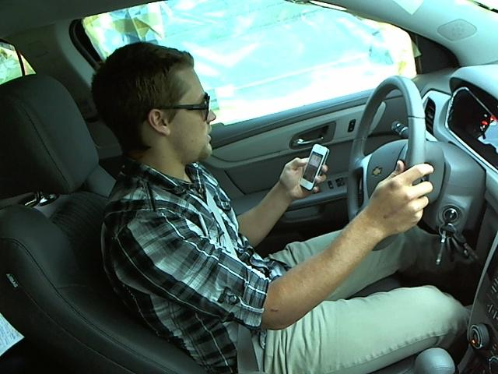
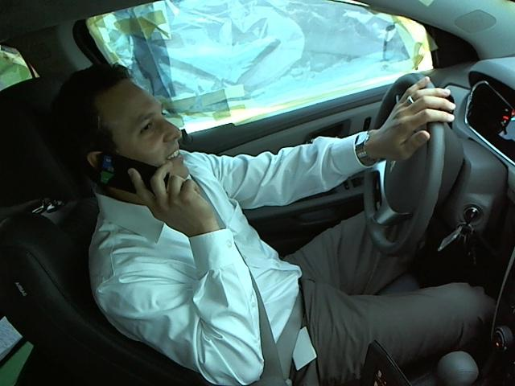
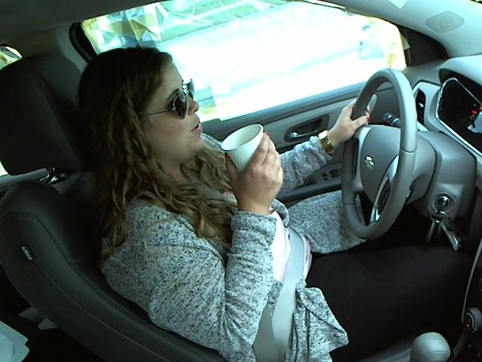
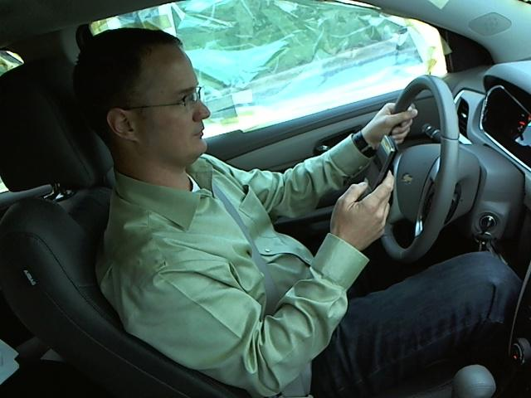
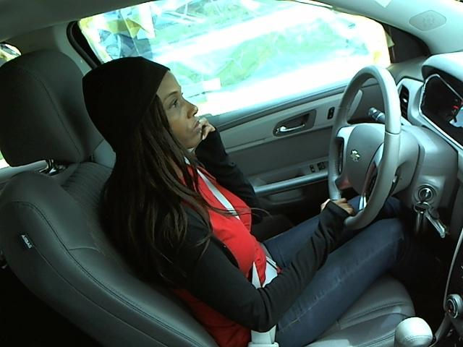
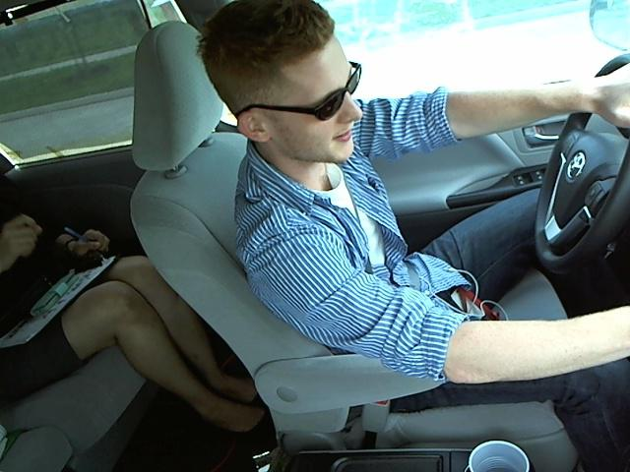
Distraction Classes
Texting
Right & Left
Talking on the phone
Right & Left
Drinking
&
Operating Radio
8
Notes:
الداته-ست بتاعتنا الي اشتغلنا عليها بتحتوي علي صور للسائق في حاله السيف درايف وتسع انواع من التشتت المختلفه الانواع دي هي

Slide 9
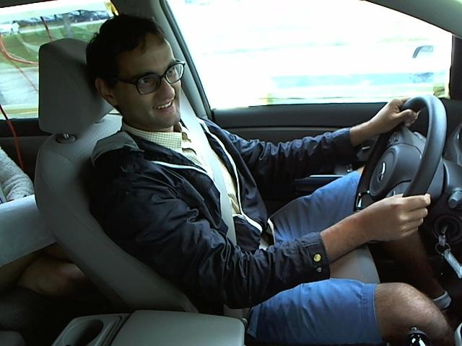
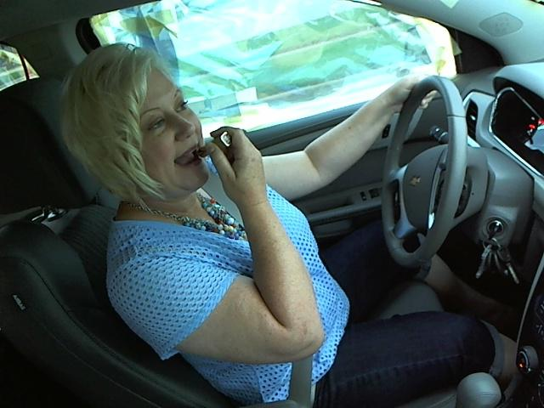
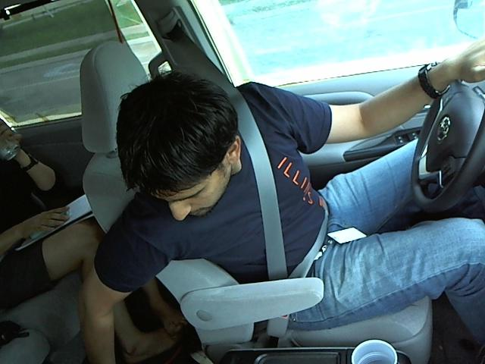
Distraction Classes
Talking to passenger
Hair and Makeup
Reaching behind
9

Slide 10
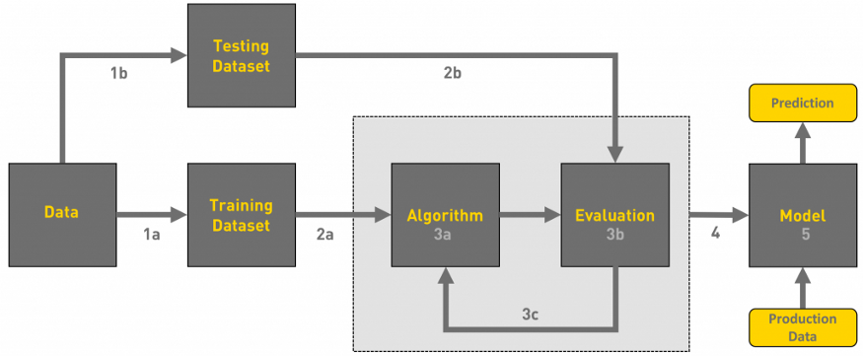
Valid
Dataset

Slide 11
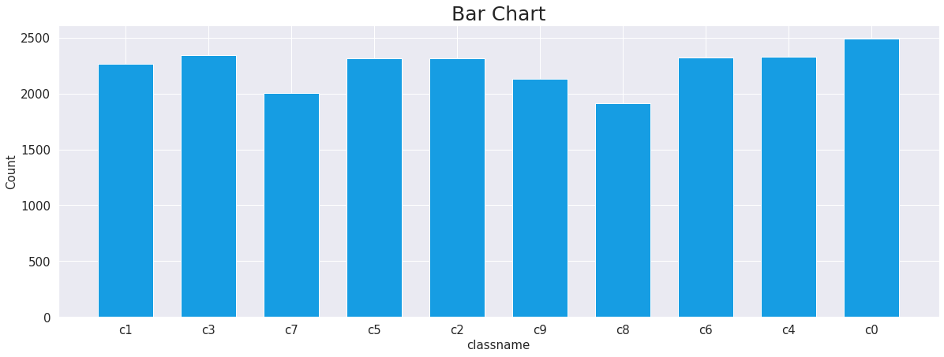
Number of Images per class
We must ensure that we have a balanced dataset

Slide 12
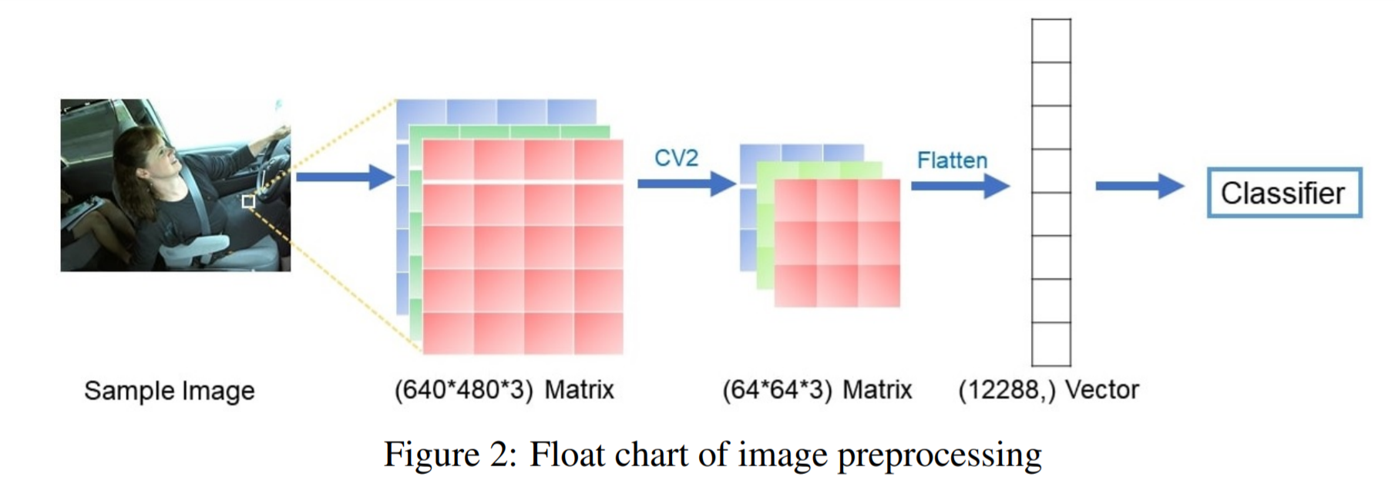
Image Processing
Image Sample
(224, 224, 1)
Matrix
(640 × 480 × 3)
Matrix
(50,176, )
Vector
Each image is first converted into a high-dimensional 640 × 480 × 3 matrix based on its RGB values on each pixel
Resized to a 224 × 224 × 1 matrix using CV2 in order to improve the computing efficiency of classifier
Finally flattened the Matrix into a vector. each flattened vector, has a numerical label in the range of 0-9 is assigned based on the class it belongs

Slide 13
Hyperparameters
Parameter | Image size | Color type | # Of Classes | #Of batches | # Of epochs | Learning rate | Beta
Value | 224x224 | Grayscale | 10 | 40 | 25 | 0.01 | 0.9

Slide 14
CNN Model Architecture
64
Filters
128
Filters
256
Filters
512
Filters
Convolution 2D
MaxPooling 2D
Convolution 2D
DroupOut
MaxPooling 2D
Convolution 2D
Convolution 2D
MaxPooling 2D
MaxPooling 2D
Convolution 2D
MaxPooling 2D
1
Input Data
Block 1
Block 2
Block 3
Block 4
Block 5
The 10 Classes
Flatten
Dense
Dense
Droupout
1
Block 6
Notes:
شرح مفصل بقي للريلز والعمليه كلها ودا بياخد وقت
ممكن تتشرح سريعا ويتقال التفاصيل اثناء الترنينج

Slide 15
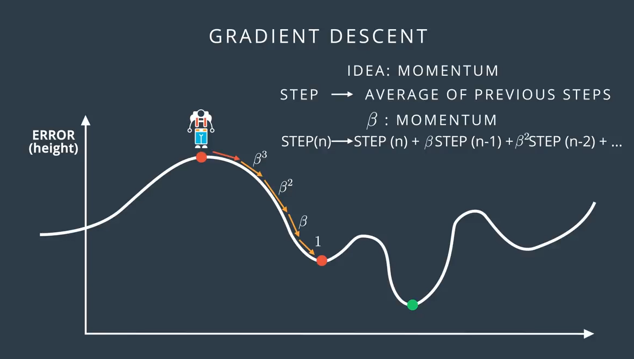
RMSprop Optimizer
We used RMSprop optimizer as it similar to the gradient descent algorithm, but it has momentum. The RMSprop optimizer restricts the oscillations in the vertical direction. Therefore, we can increase our learning rate and our algorithm could take larger steps in the horizontal direction converging faster

Slide 16
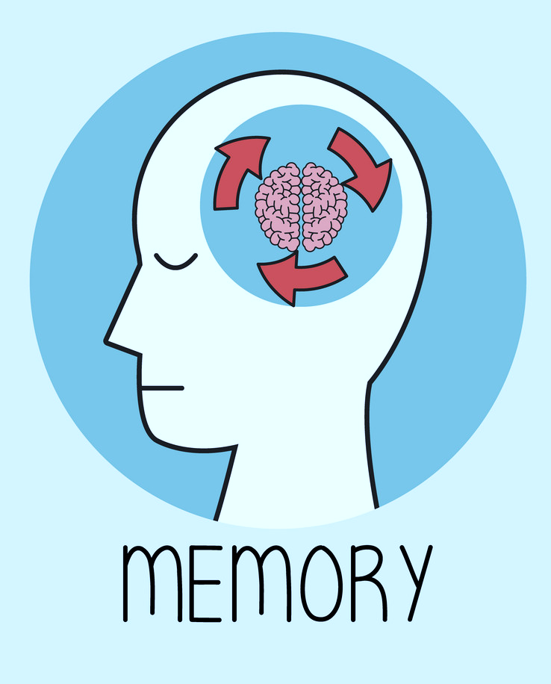
Callback
ModelCheckpoint callback is used in conjunction with training to save a model or weights (in a checkpoint file) at some interval, so the model or weights can be loaded later to continue the training from the state saved.

Slide 17
Batch Normalization
normalization is commonly used in the machine learning area and aims to speed up the training process
Especially in CNN applications, batch normalization is used not only in the input layer but also in the hidden layers. This prevents the weights and outputs from reaching extremely high or extremely low values throughout the entire network.

Slide 18
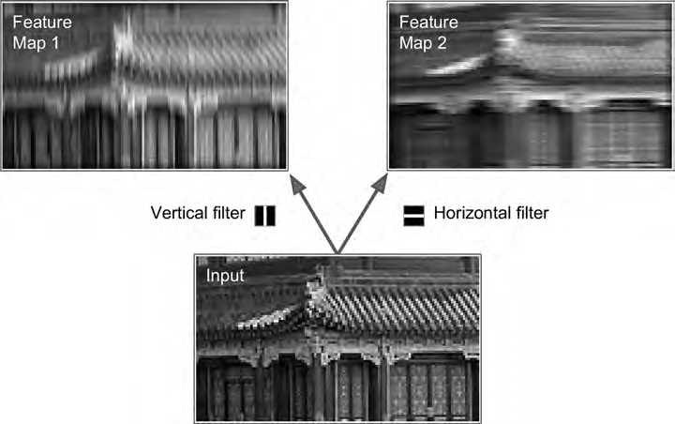
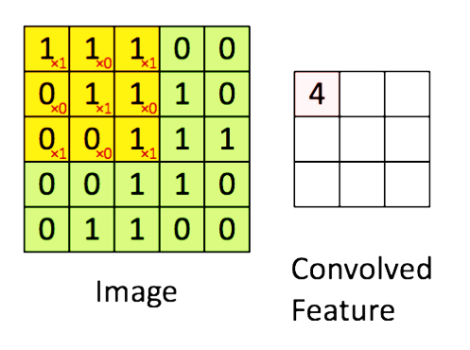
ConvNet2D Layer
In CNN, basic features such as lines, edges, and colors are learned in the ConvNet2D layer using kernels or filters.

Slide 19
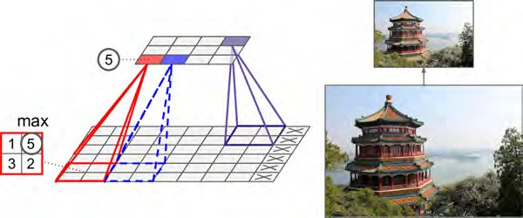
MaxPooling2D Layer
Calculate the maximum value for each patch of the feature map.
Notes:
ودا عشان اخد الفيتشرز الاكثر اهميه والباقي اهمله لان مش هيفيدني ف عمليه اليرننج

Slide 20
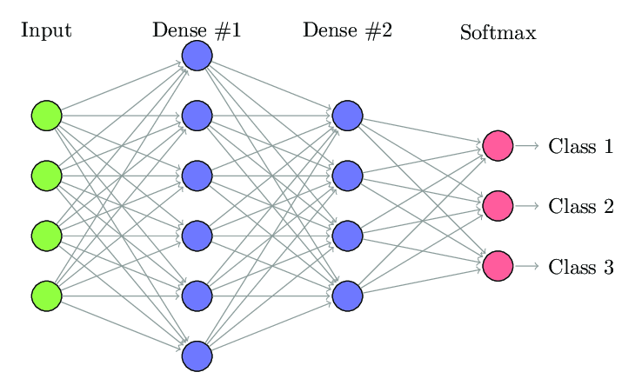
Flatten, Dense Layer

Slide 21
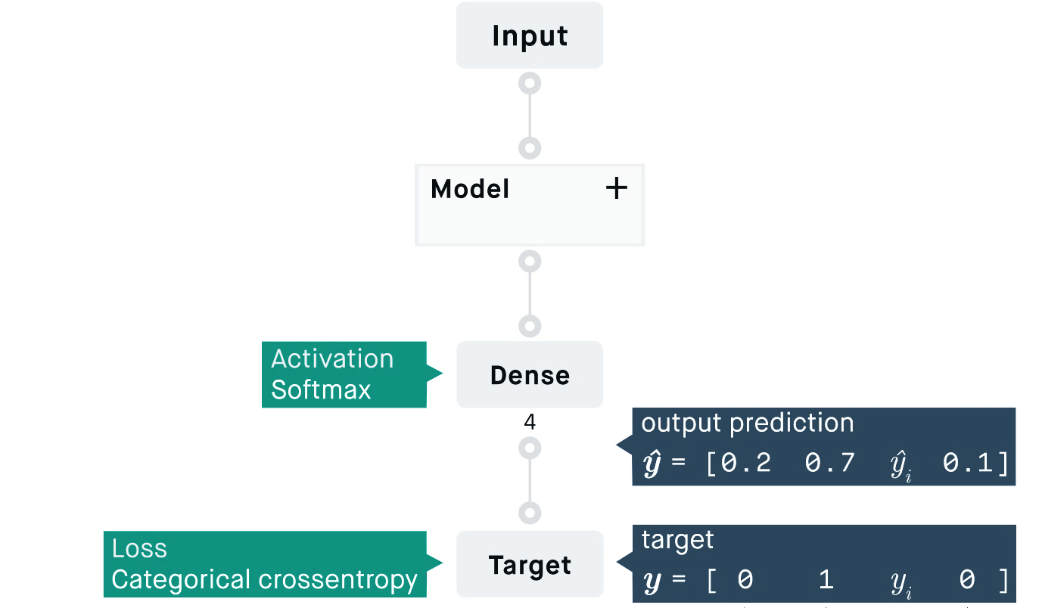
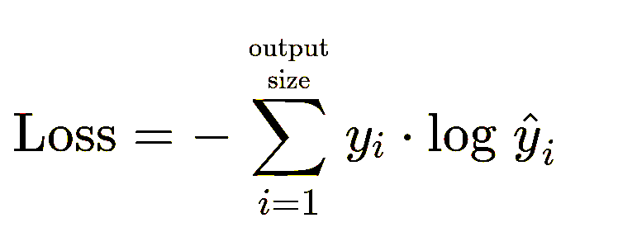
Categorical Cross-Entropy loss Optimizer
Also called Softmax Loss. It is a Softmax activation plus a Cross-Entropy loss. If we use this loss, we will train a CNN to output a probability over the more than class. It is used for multi-class classification.

Slide 22
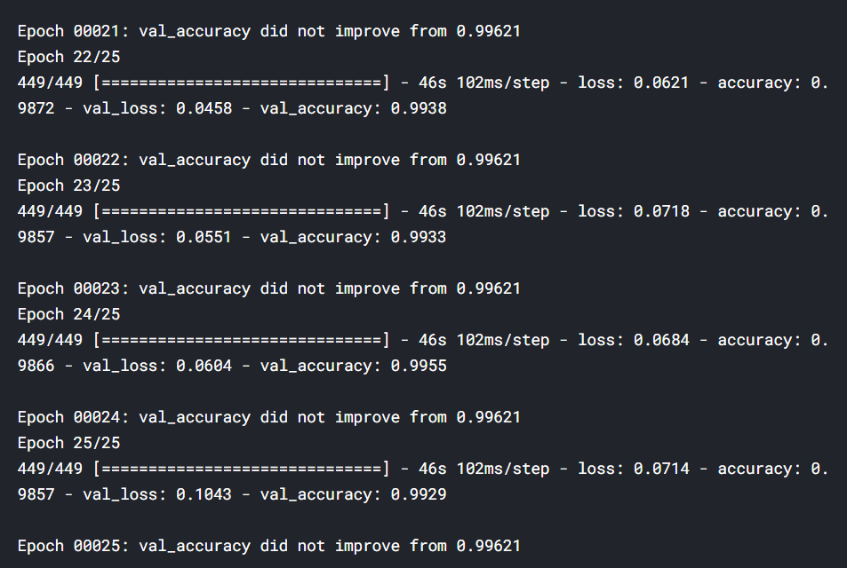
After 25 epochs the validation accuracy is 99.3%

Slide 23
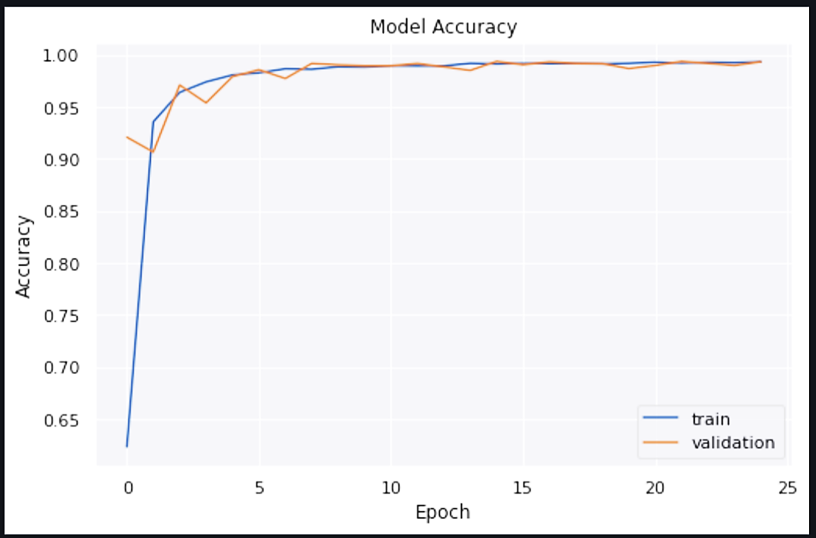
Train and validation Accuracy
23

Slide 24
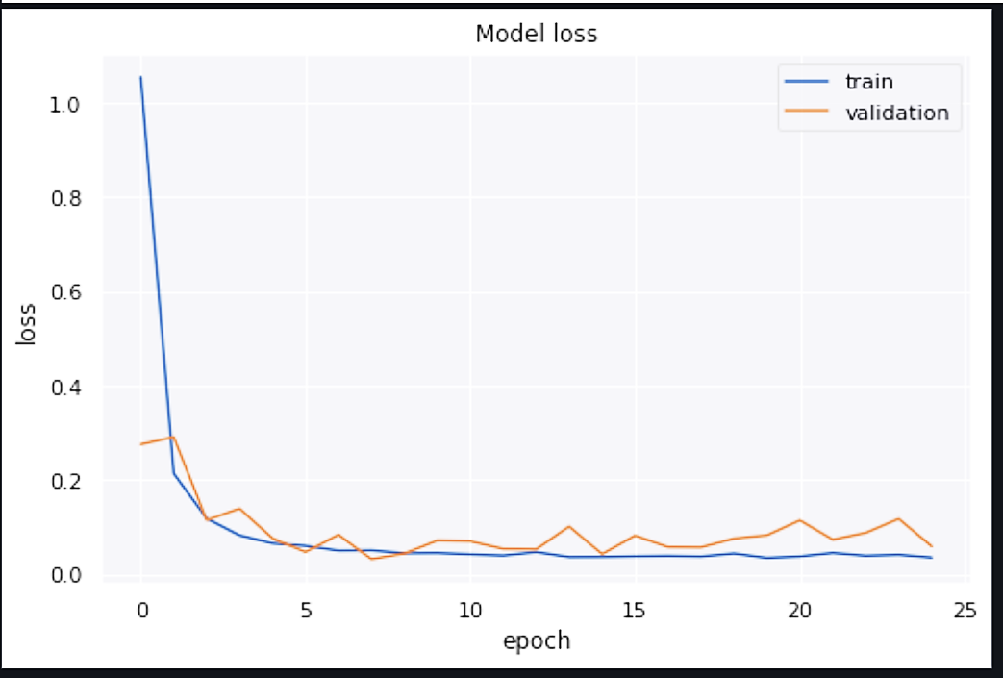
Train and validation Losses

Slide 25
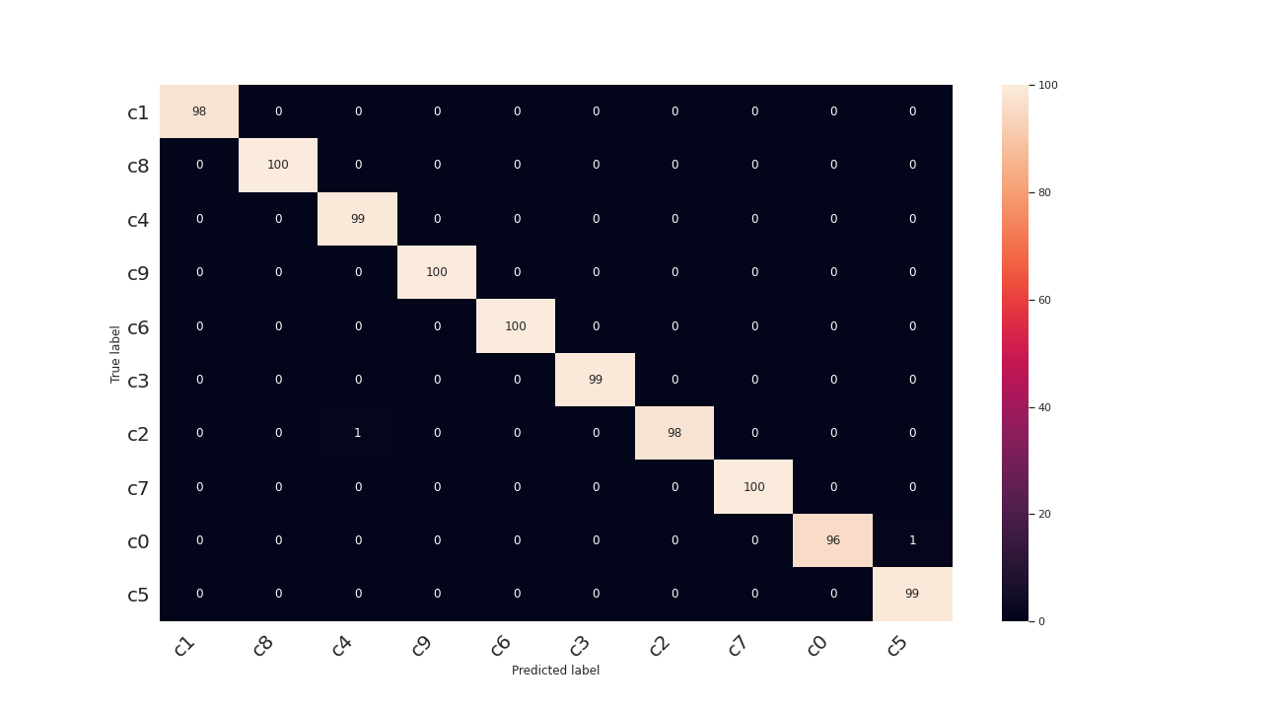
Confusion matrix of Validation Dataset
25

Slide 26
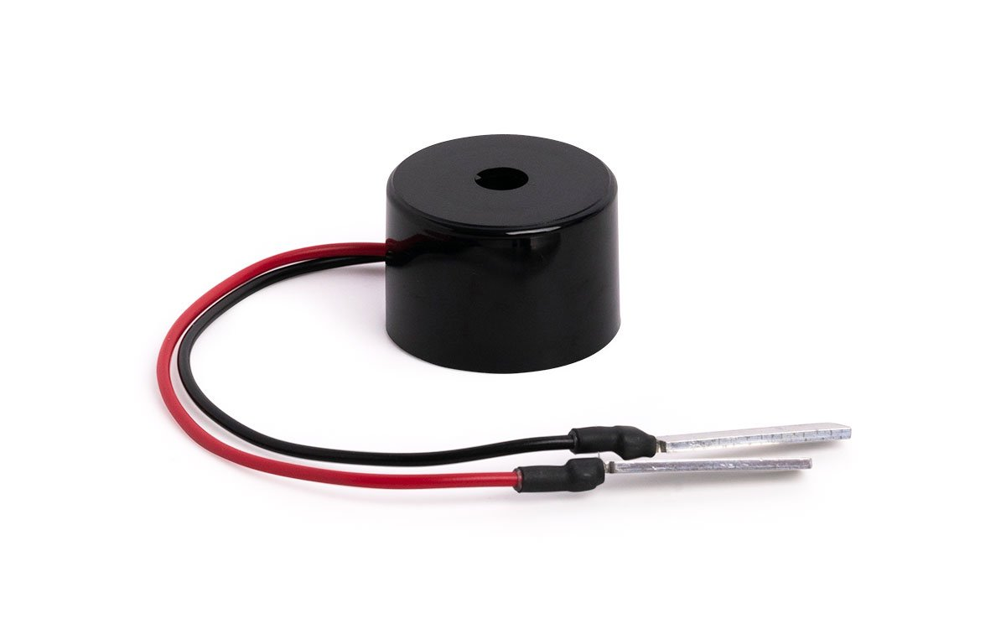
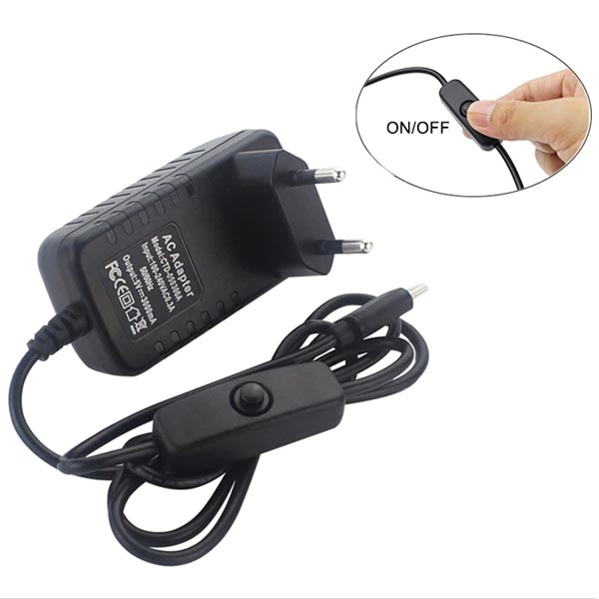
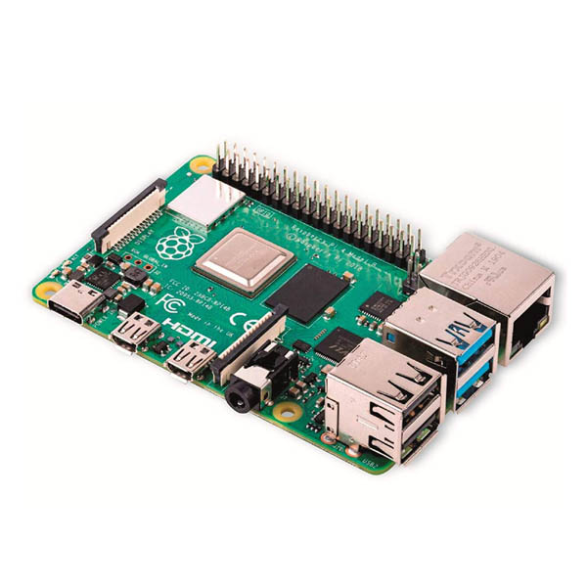
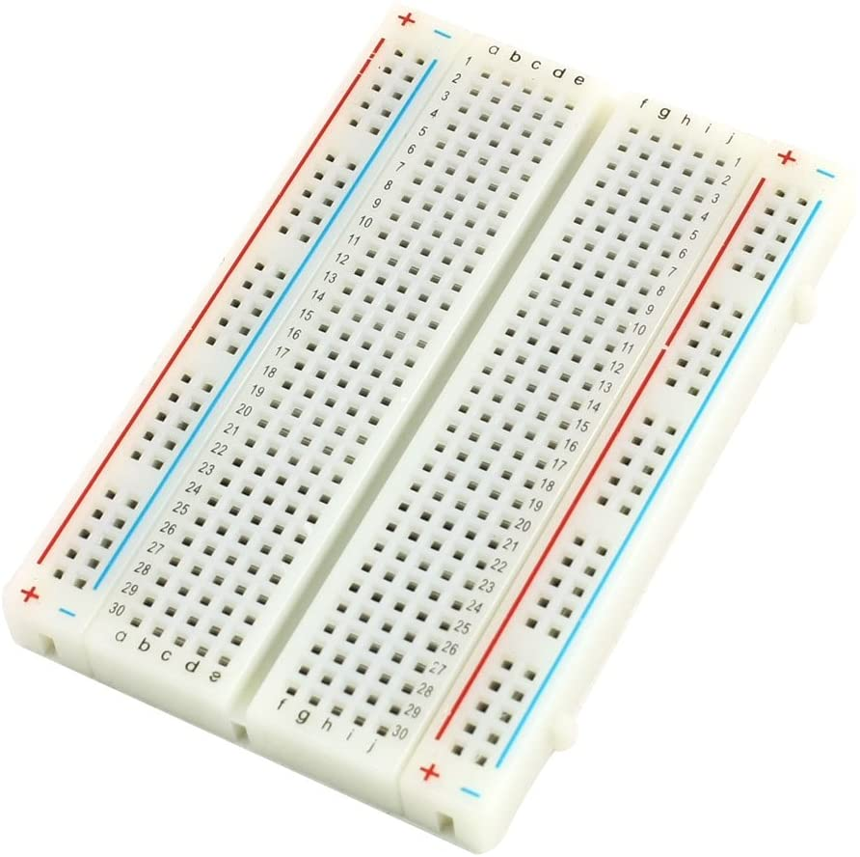
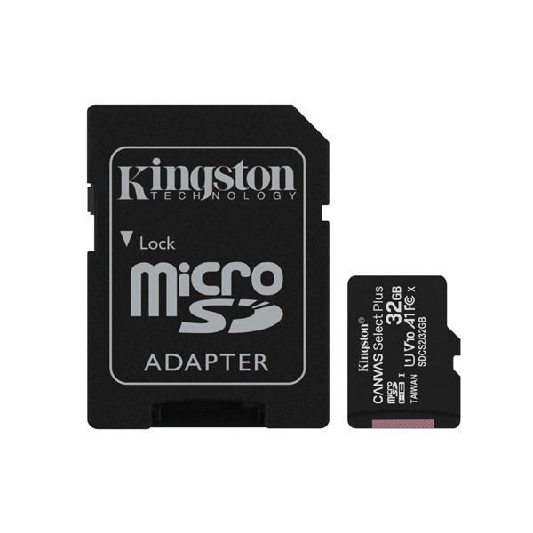
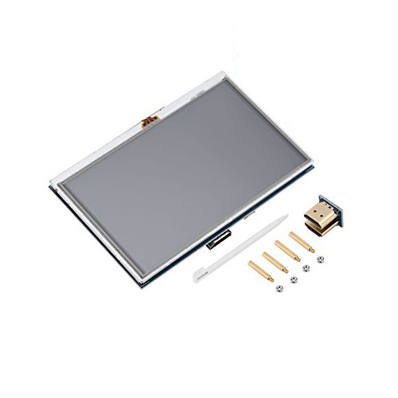
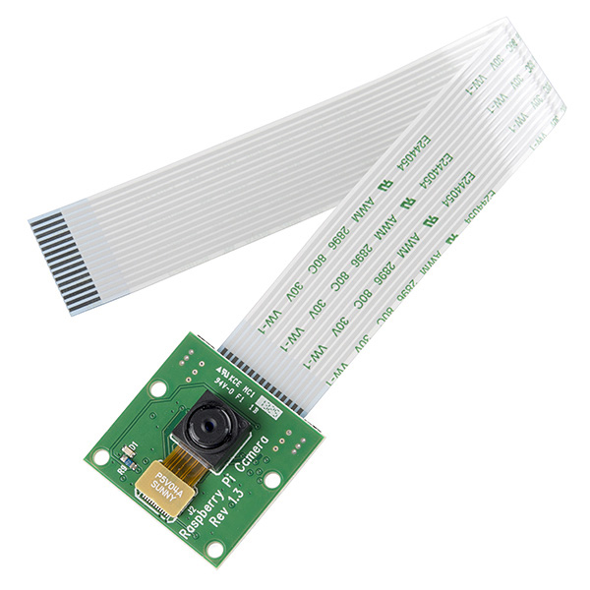
Hardware
26

Slide 27
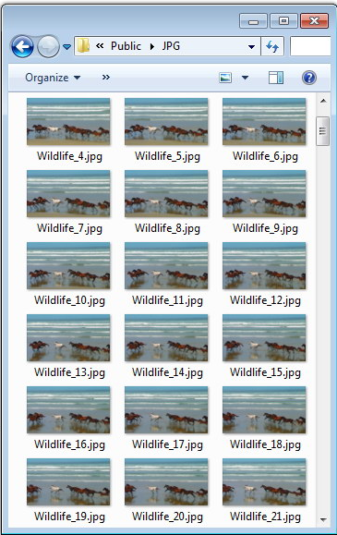
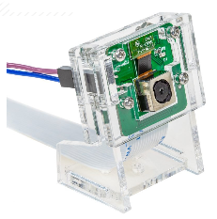
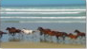
Pi Camera Driver
Cv2.videocapture(0)
OpenCV library is used to operate raspberry pi camera by capturing the frames and storing every frame in specified directory.
OS library is used to remove the captured frames when the program is stopped.
cv2.imread()
cv2.imwrite()
os.remove()
27

Slide 28
Flow Chart
Start
No
Stop pressed?
Image counter+1
Capture frame
Store frame
Yes
Remove all frames
Image counter=0
End
28

Slide 29

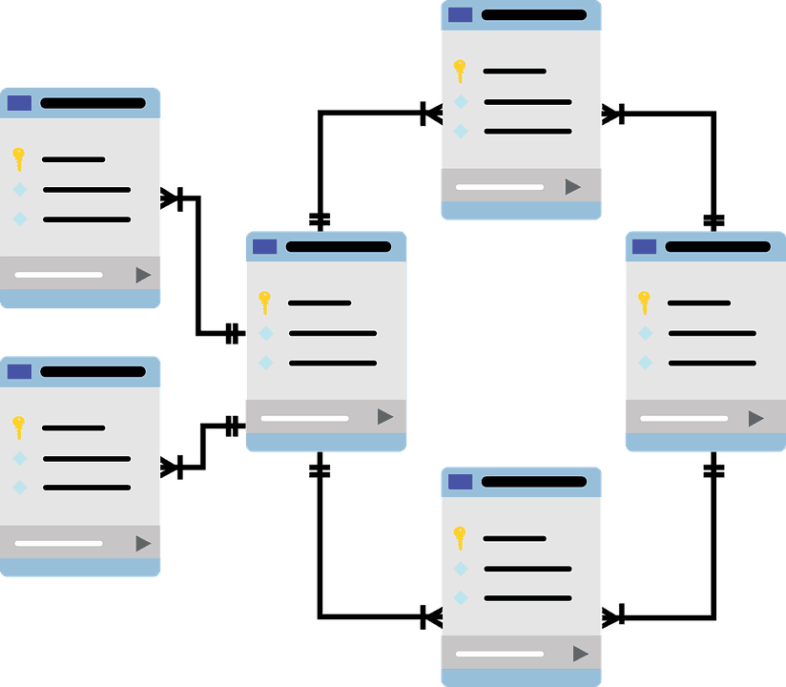
MySQL
MySQL is a relational DBMS, it defines relationships in forms of tables and usually have predefined datatype mostly used in web database.
MySQL- Python Connector is preferred over phpMyAdmin because we needed to interact with database using model and GUI which are written in python.
29

Slide 30
Design
date | time | counter | Safe drive | Texting left | Texting right | Talking on the phone left | Talking on the phone Right | Reaching behind | Hair and Makeup | Drinking | Operating Radio | Talking to passenger
2021-07-06 | 10:05:02 | 1 | 0 | 0 | 0 | 0 | 0 | 1 | 0 | 0 | 0 | 0
Date and Time are datetime objects in python formatted to a string.
Columns (3-13) are integer type counters synced with the model
30

Slide 31
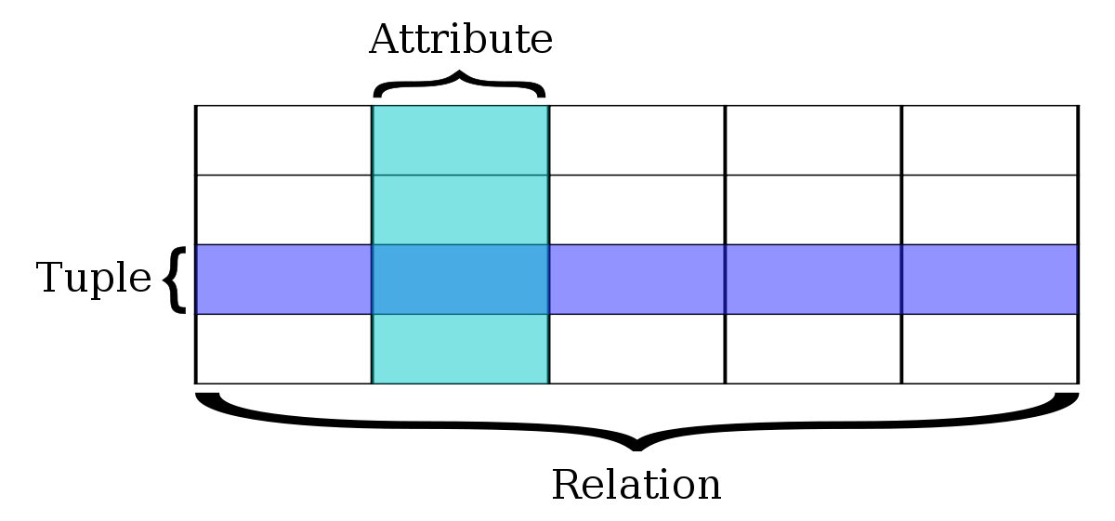
Input and output
Insert is the query responsible for inserting variable data in table, the variable must be a tuple type.
select is the query responsible for fetching variable data from table, the data fetched inside a list containing tuples.
31

Slide 32

GUI
We needed to provide the driver the ability to operate the device by temporarily or permanently turning it on or off.
We needed to present some data on driver distraction during the drive.
32

Slide 33
GUI
GUI lets users to interact with electronic equipment using graphical icons and aural indicators such as primary notation.
Many libraries are available, such as PyQt5, Kivy, WxPyThon, PyForms, and Tkinter.
Tkinter is the liberary who helped us create our project's GUI.
33

Slide 34
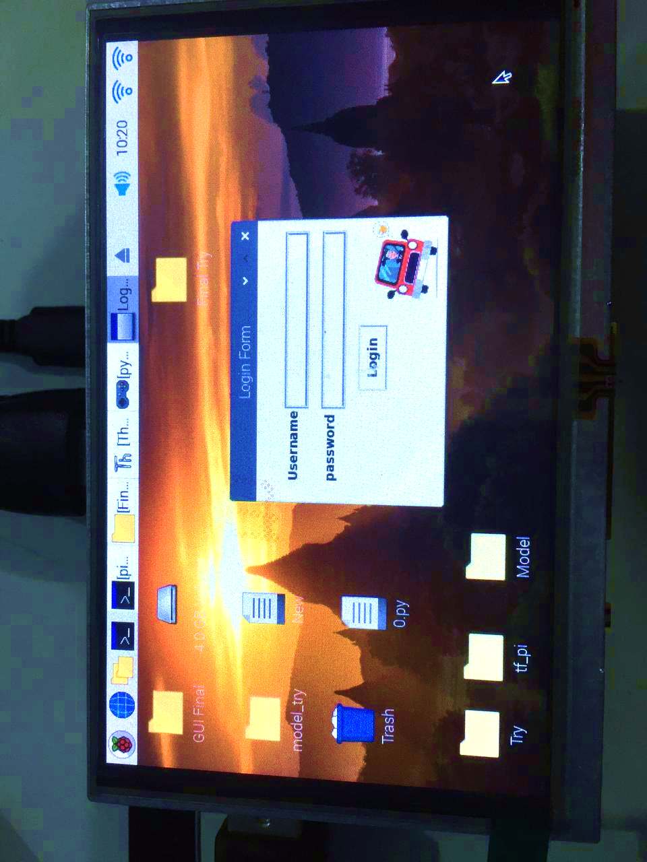

Slide 35
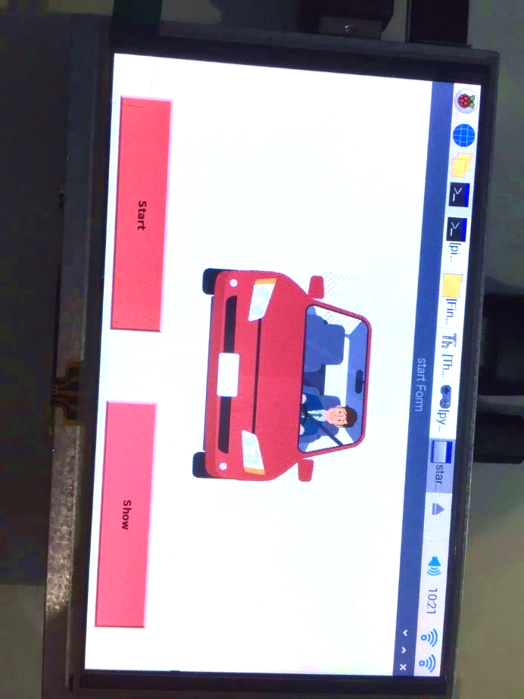

Slide 36
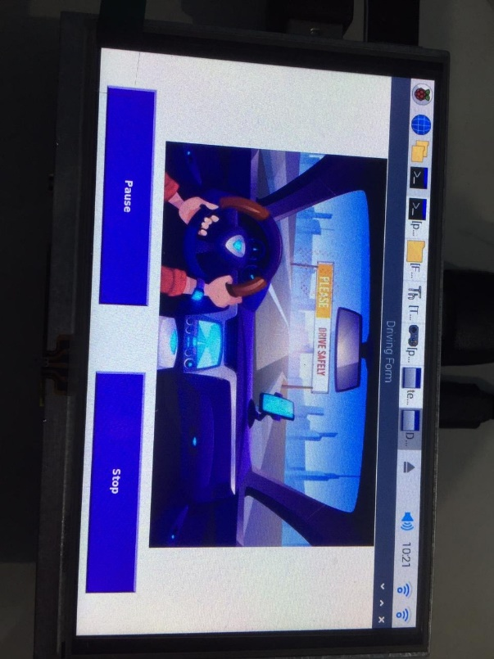

Slide 37
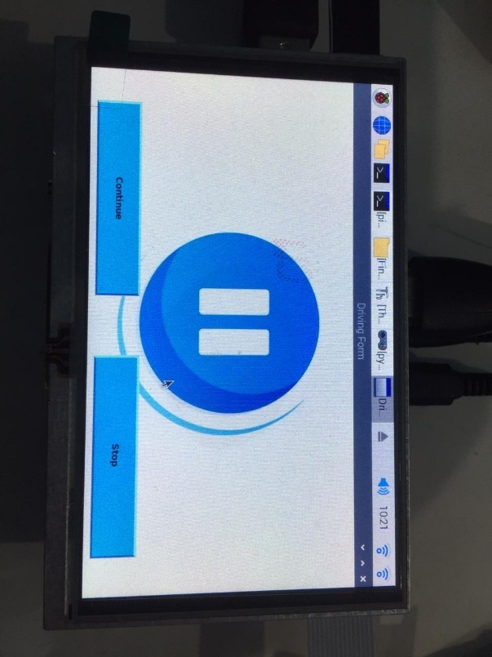

Slide 38
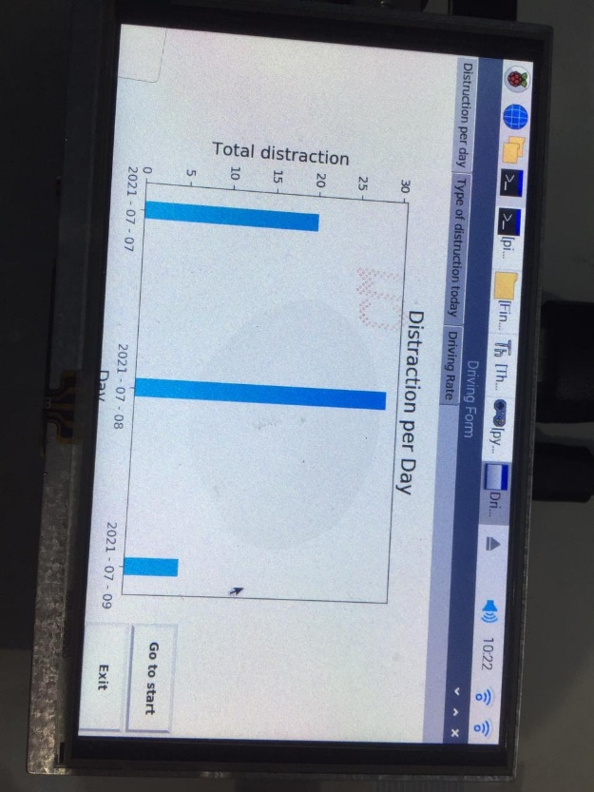

Slide 39
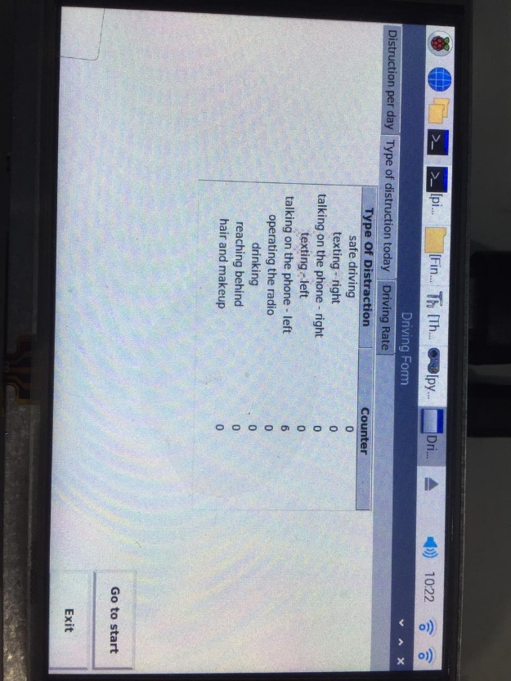

Slide 40
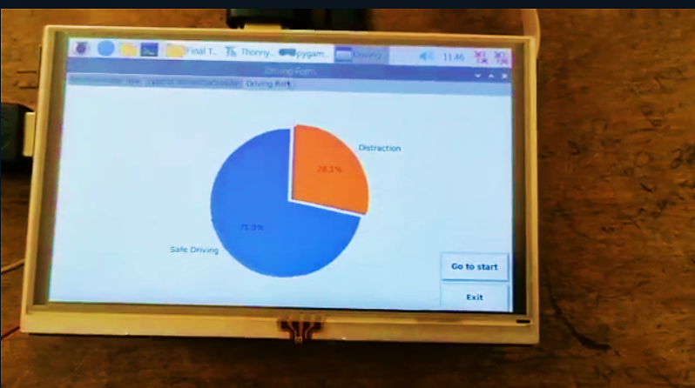

Slide 41


Future Work
Cognitive distractions are distractions of the mind. While they may not be commonly thought of as distractions, they most certainly are, and they can be just as dangerous as visual and manual distractions.
Visual distractions are exactly what they sound like: visual stimuli which attract your eyes, pulling them off of the road. These distractions are extremely common and are oftentimes unavoidable.
41

Slide 42
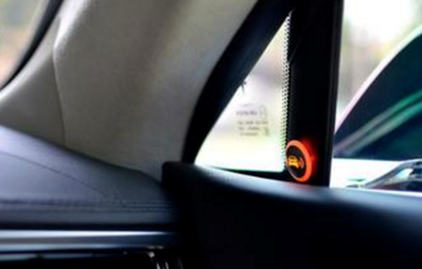
Future Work
BLIND SPOT WARNING
What it does?
How it works?
Notes:
Let's you know if something is in your blind spot.
Sensors are installed in the front and/or rear bumpers to detect traffic surrounding traffic. Alerts are installed in the car (usually near the rear-view mirrors) and flash when there’s something in your blind spot.
Adding extra sensors to the device to maintain the driver's safety, as well as linking the outputs of these sensors to the driver's phone so that, in the case of a medical emergency or an accident, a call may be made to the emergency numbers on the list.

Slide 43
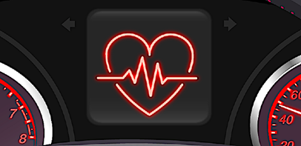
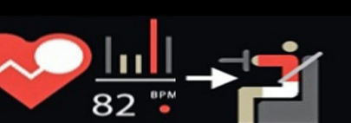
Future Work
HEALTH DETECTOR
What it does?
How it works?
Notes:
: Let the driver knows his blood pressure and heart beat.
Health sensing in cars showed off concepts ranging from a heart rate sensing car seat to a blood pressure-monitoring steering wheel. But those ideas were never produced due to cost and other factors.

Slide 44

Thanks!

Slide 45


